Slide 1
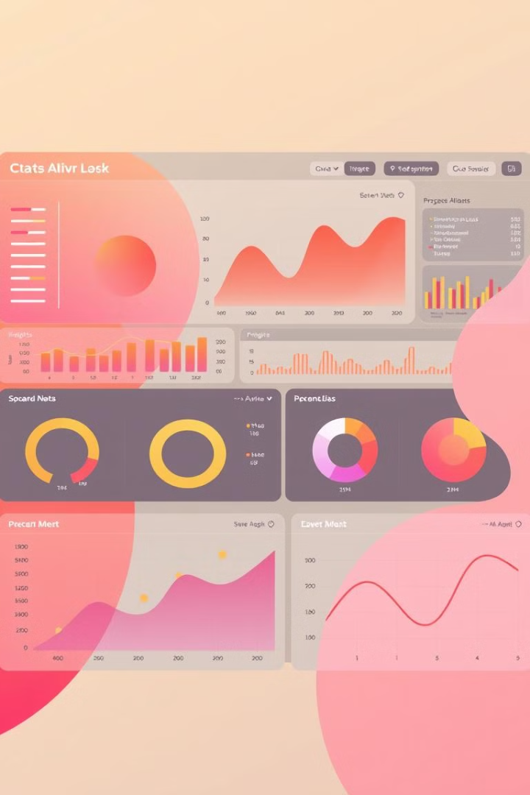
Customer Segmentation Analysis using Power BI
This project explores the powerful insights revealed through customer segmentation analysis using Power BI. We will analyze the Myntra ecommerce dataset to understand customer purchasing patterns and develop tailored marketing strategies.
By - Lavanya Arigela

Slide 2
Introduction to Power BI
What is Power BI?
Benefits of Power BI
Power BI is a business intelligence and data visualization tool that helps businesses gain insights from their data. It offers a user-friendly interface and powerful capabilities for data analysis and visualization.
Power BI enables businesses to create interactive dashboards, track key performance indicators (KPIs), and gain actionable insights from their data.

Slide 3
Data to Insights Journey
Data Collection
1
Gathering relevant data from various sources.
Data Exploration & Cleaning
2
Understanding data structure, identifying inconsistencies, and cleaning the data.
Exploratory Data Analysis
3
Analyzing patterns, trends, and relationships in the data.
Visualizing Insights
4
Creating interactive dashboards using Power BI to showcase key findings.
Actionable Insights & Recommendations
5
Drawing conclusions from data analysis and suggesting improvements based on insights.

Slide 4

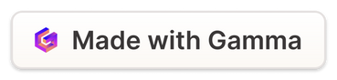
Data Collection
Myntra Dataset
Internal Data Sources
The Myntra customer dataset from Kaggle provides a comprehensive view of customer behavior and preferences, including demographics, purchase history, and product interactions.
Leveraging existing customer data from Myntra's internal databases, such as sales records, website activity logs, and marketing campaigns.

Slide 5
Exploring the Myntra Ecommerce Dataset: Key Attributes and Metrics
Customer Demographics
Purchase History
Product Categories
Review Ratings
Customer Age, gender, City, State and provide a foundation for understanding your customer base.
Data on past purchases, including product categories, frequency, Discounts applied and value, reveal purchasing patterns and preferences.
Understanding the types of products such as Brands, category, sizes helps tailor marketing and product development efforts.
Customer reviews offer valuable insights into product satisfaction and overall customer experience.

Slide 6

Cleaning and Transformation
Data Cleaning
Data Transformation
1
2
Removing duplicates, handling missing values, and correcting inconsistencies ensures accurate data analysis.
Reshaping the data for analysis by aggregating, grouping, and creating new variables.
Eg: Removed Customer names, change size data type into text.
Eg: Creating new measures

Slide 7



Implementing DAX Functions for Myntra Dataset :
New Columns
It contains new features that are used to derive other useful metrics
1
Eg : Discounts, Original price
Date Table
2
It contains only date-related data, such as when the products were purchased
Eg: Date, Month ID, Month Name, Week ID, Year
Measure Table
It contains a summary of sales and ratings, including the overall average and total of all information.
3
Eg: Avg discount, Avg original price, Avg rating, Avg sales, Sum of original price, Total orders, Total sales

Slide 8
Exploratory Data Analysis
Purchase Frequency Analysis
Understand how often customers purchase, identifying trends such as seasonality.
1
Product Category Analysis
Understand which product categories are performing best, helping in inventory management and marketing focus.
2
Customer Demographics Analysis
Understand the demographic distribution (age, gender, region) of customers to target marketing efforts effectively.
3

Slide 9
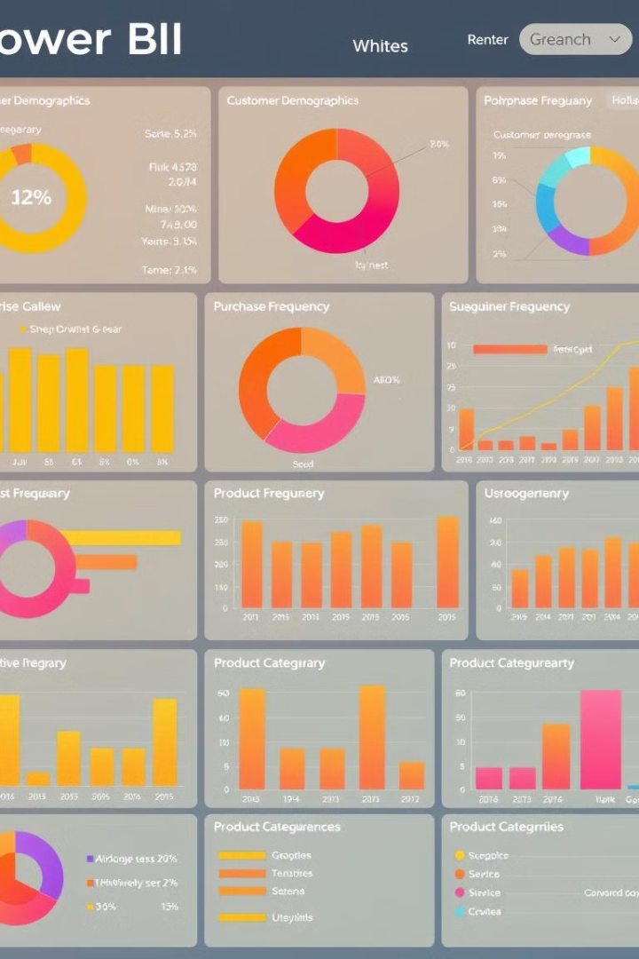



Visualizing Customer Purchasing Patterns: Identifying Trends and Behaviors
Sales Trend Analysis
Customer Segment Breakdown
Visualize sales trends over time to identify seasonal - Line and Stacked column chart
Use pie charts to illustrate order distribution - Pie chart
Sales by Age group - Donut chart
Category Ranking By sales - Ribbon chart
Product Category Analysis
Scatter plots can reveal relationships between sales and discount by rating.

Slide 10
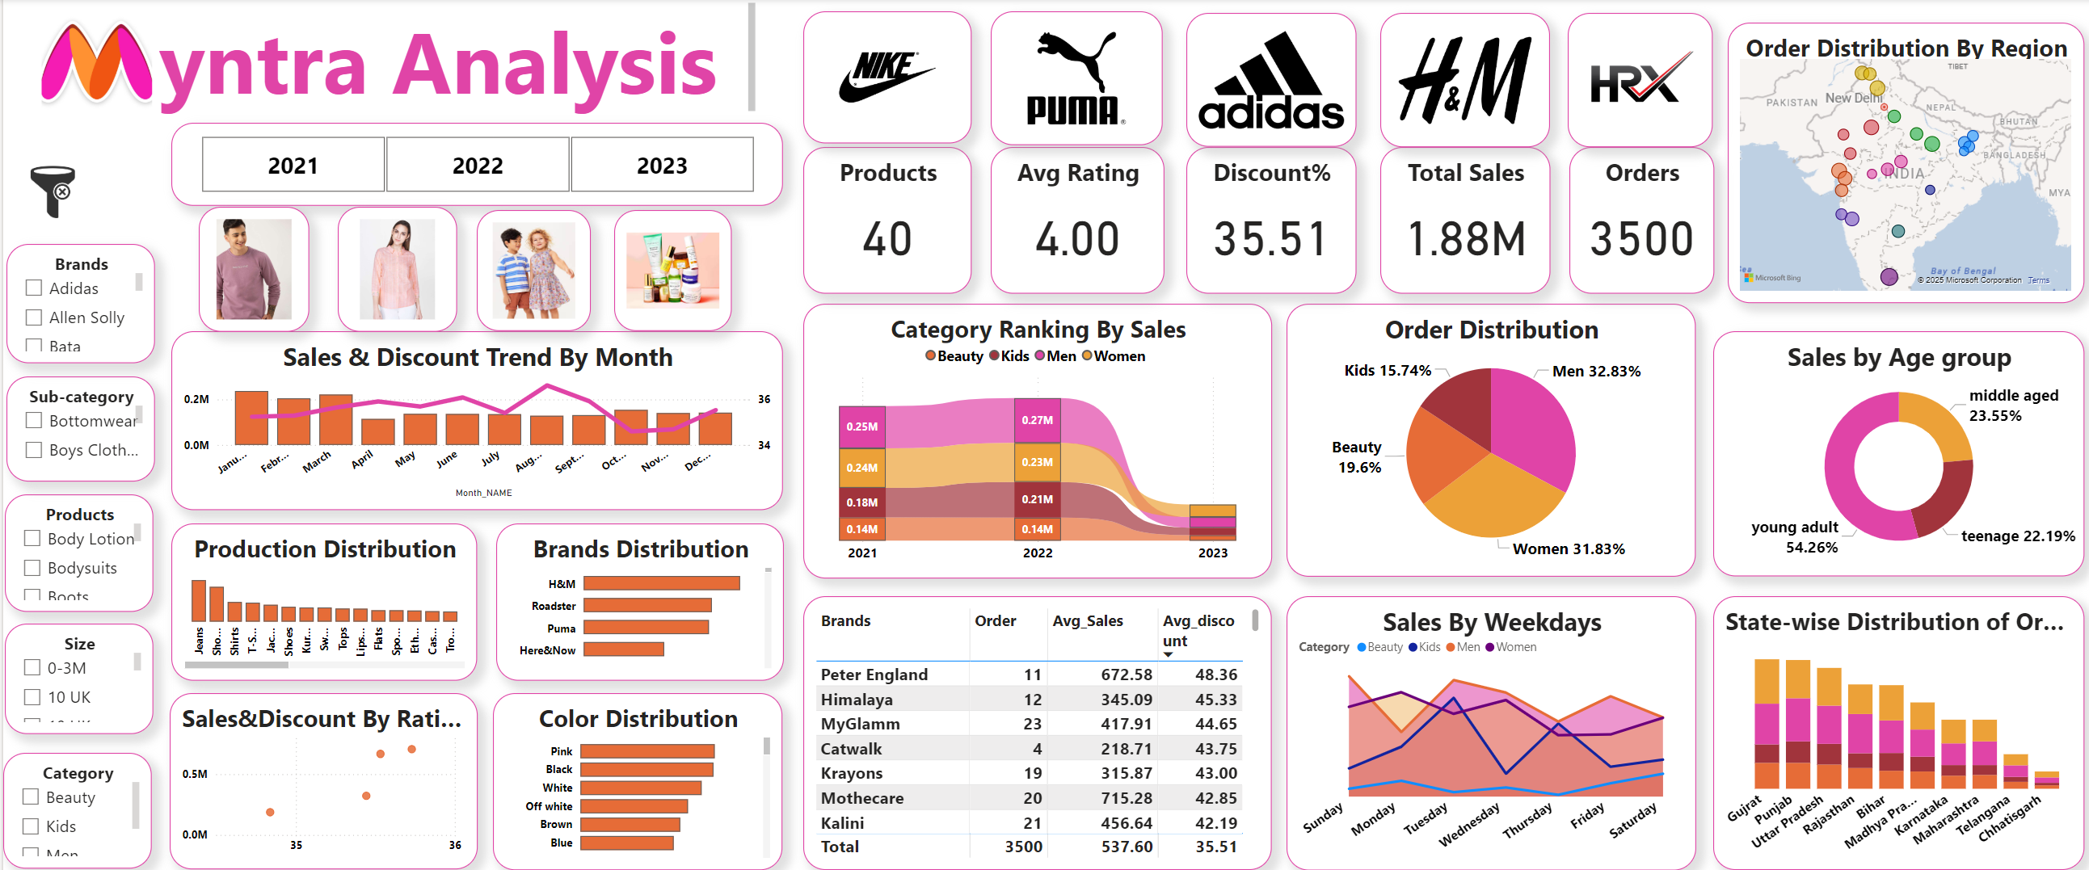

Slide 11
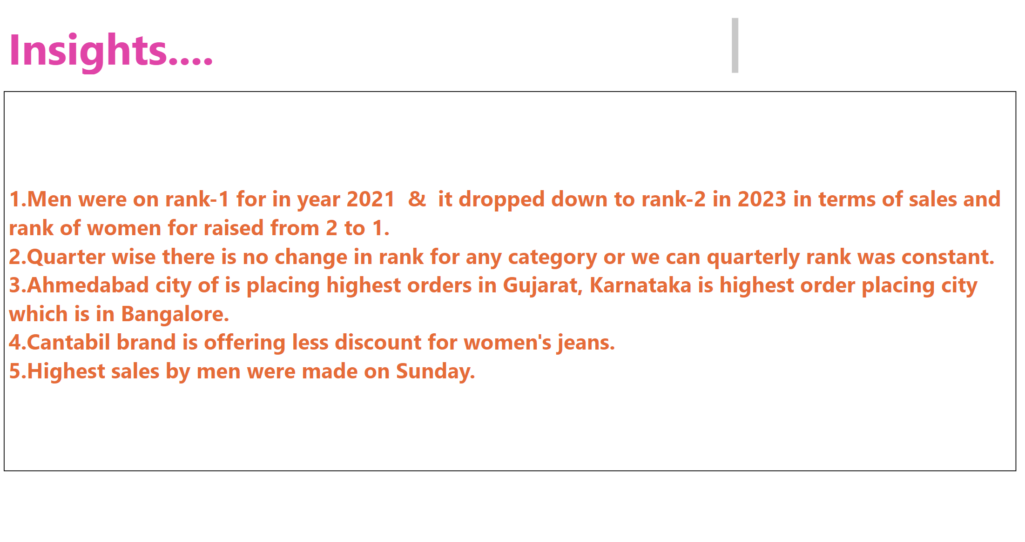

Slide 12




Uncovering Insights: Interpreting the Dashboard Visualizations
High Value Customer
Men lead in both sales and orders, while young adults contribute the highest sales overall.
Product Preference
Jeans, Pink, and H&M categories have the highest orders, Puma leads in sales, and discounts are predominantly applied to the Peter England brand.
Purchase Frequency
High purchase activity occurs in January, driven by the highest sales, while August sees a surge in purchase due to max discounts.

Slide 13

Actionable Recommendations: Tailoring Marketing Strategies for Each Segment
Personalized Promotions
Targeted Content Marketing
Offer personalized promotions like exclusive discounts for young adults and region-specific deals for Bangalore.
Use targeted content marketing to highlight trendy brands like H&M and Puma, and popular colors like Pink.
Customer Loyalty Programs
Launch a customer Loyalty program with rewards for frequent purchases and special perks during high-sales months like January.

Slide 14
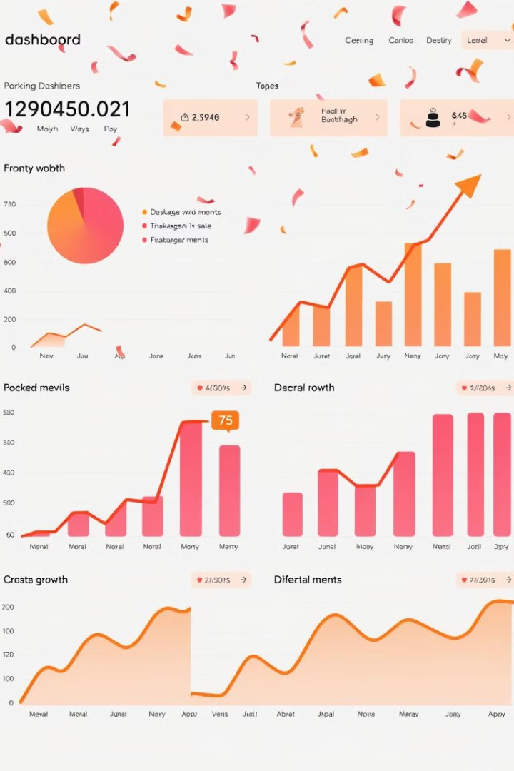
Conclusion: Driving Business Growth through Effective Customer Segmentation
Myntra's ability to analyze customer behavior and preferences empowers the company to align its strategies with market demand. By leveraging data-driven insights, it can create targeted campaigns, optimize resources, and enhance the overall shopping experience. This approach ensures long-term growth and customer satisfaction while maintaining a competitive edge.

Slide 15

THANK YOU

